Slide 1
Clinical Considerations
MTN 020 Training

Slide 2
Outline
Medical Menstrual History Update
Physical and Pelvic Exams
Pelvic Exam Terminology
Pelvic Exam and Specific Visit Considerations
Specific Clinical Management Considerations

Slide 3
Follow-Up Medical/Menstrual History
An updated participant self reported medical/menstrual history is required at each scheduled visit
Two objectives of the follow-up history
  Determine whether previously documented conditions have changed
  Determine whether new AEs have occurred since the last history was obtained
History should also be obtained at interim visits, as clinically indicated

Slide 4
Follow-Up Medical/Menstrual History Documentation
“How are you?”
  Chart note
Review PRE-CRF
  Follow-up on ppt-reported baseline symptoms/conditions still ongoing
  Document resolution of ppt-reported items in chart notes
Review AE and GAE CRFs
  Follow up on and update as needed ppt-reported conditions on AE and GAE CRFs that are continuing; add new events as needed
Menstrual history/dates captured on Family Planning CRF (covered previously)
Cross-check with Con Meds Log as needed

Slide 5
Follow-up Medical History Documentation and Considerations
Documentation of review is required in a chart note, even if nothing has changed
  Example: “Ppt reported no changes in conditions or symptoms since last visit”
Participants will see a number of staff members throughout the visit and may report different or varying symptoms during the visit
  How will the team ensure that documentation is consistent in the chart notes? How will discrepancies be addressed?

Slide 6
Physical and Pelvic Exams

Slide 7
Physical Exam
Required at
  Screening
  Enrollment (abbreviated)
  Quarterly (abbreviated)
  PUEV (abbreviated)
  When clinically indicated (abbreviated)
Applicable physical exam CRF is recommended source document (Screening, Enrollment, Abbreviated)
Medically relevant abnormal findings
  Per Baseline Med Hx presentation, transcribe medically-relevant abnormal findings at SV or EV onto PRE CRF
  During follow-up, transcribe abnormalities onto GAE or AE CRF as needed
All visits – cross-reference with Con Meds Log

Slide 8

Physical Exam
Vital signs
  Height
  Weight
  Oral temperature
  Blood pressure
  Pulse
  Respirations
Clinical assessments of
  General Appearance
  Lymph nodes
  Neck
  Heart
  Lungs
  Abdomen
  Extremities
  Neurological
  Skin
Other assessments at discretion of examining clinician
Notes:
Complete physical exam will be conducted at screening visit and a targeted physical exam for all subsequent scheduled visits.
Bolded and underlined components are required at follow up

Slide 9
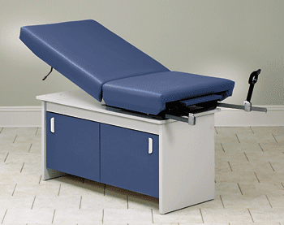
Pelvic Exam
When is it performed?
  Screening, Semi-Annually, PUEV/early termination, and as clinically indicated
  No longer required at Enrollment per LOA#1
  Pay careful attention to which evaluations are required at all exams, which are required at some but not all exams, and which are required only when clinically indicated

Slide 10
Pelvic Exam
To be performed after the ring comes out
Two person team: examining clinician and assistant
Ensure all possibly-required supplies and paperwork are easily accessible in exam room
Review specimen collection requirements for each visit in preparation for each exam
Pay careful attention to the required sequence of swab collection and required handling of each swab

Slide 11
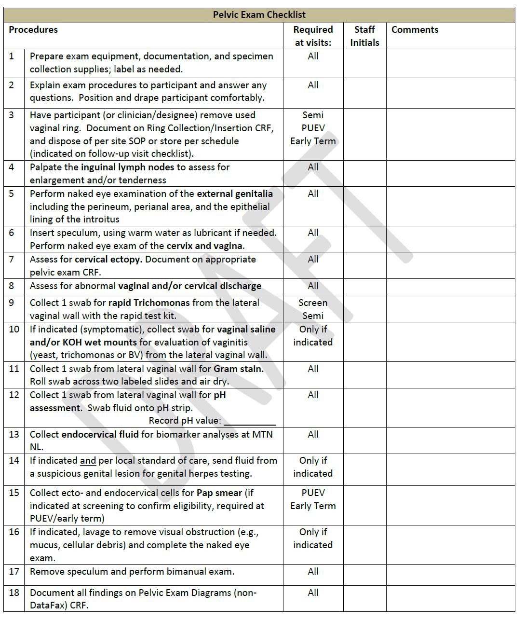
Notes:
Instructions:
This checklist should be used for every scheduled pelvic exam; it should not be used for clinically indicated pelvic exams. The “Required at visits” column indicates when the item is required during follow-up per-protocol. When an item is performed, complete “Staff Initials” cell. If not done but required, write “ND” and staff initials in “Staff Initials” cell, and provide more details in the chart notes as needed. Do not initial for other staff members. If other staff members are not available to initial items themselves, write and initial/date a note documenting who completed the procedure, e.g., “done by {name}” or “done by nurse.” Samples must be collected in the order listed on the checklist.

Slide 12
Self Collected Vaginal Swabs
Collected at Enrollment (LoA#2), Monthly, PUEV, and Termination Visits
May be collected by clinician if a pelvic exam is to be done at the visit
Collect swab even if ppt is menstruating
IMPORTANT: collect swab while ring from previous visit is still in place
Collection of swab, blood on swab, and ring placement at swab collection documented on Specimen Storage CRF
Notes:
Section 10.9 of the ssp, clinician can collect the swab instead of the participant if a pelvic exam is being conducted (or as needed).
The swab can be collected during menstruation
The ring from the previous visit should still be inserted when the swab is collected.

Slide 13
Pelvic Exam Terminology

Slide 14

Well-Defined Terms
Makes communication between investigators easier
Can be used to double-check what is recorded regarding intactness of the epithelium and blood vessels

Slide 15
Pelvic Exam Terminology
To document findings, use terms from the pelvic exam case report form or FGGT
These terms largely match the FGGT
  Ecchymosis is listed on CRF but not on FGGT
  Petechiae is listed neither place but is referenced in protocol
    Always grade 1 per SSP
  Use routine QC/QA opportunities to help ensure consistency of terminology across staff and exams

Slide 16
Common Pelvic Finding Terms
Erythema
Edema
Petechiae
Ecchymosis
Peeling
Ulceration
Abrasion
Laceration

Slide 17
Pelvic Exam Findings Review
Epithelial Disruption
Erythema
Edema
ALL IMPACT PRODUCT USE

Slide 18
Epithelial Disruption
Extent of epithelial disruption helps to distinguish between findings
Superficial epithelial disruption
  Does not penetrate into the subepithelial tissue
Deep epithelial disruption
  Penetrates into and exposes subepithelial tissue and possibly vessels

Slide 19
Epithelial Disruption (2)
If bleeding from finding is present, disruption should be recorded as deep when in doubt
Assessment of disruption depth is subjective, even with magnification of colposcopy

Slide 20
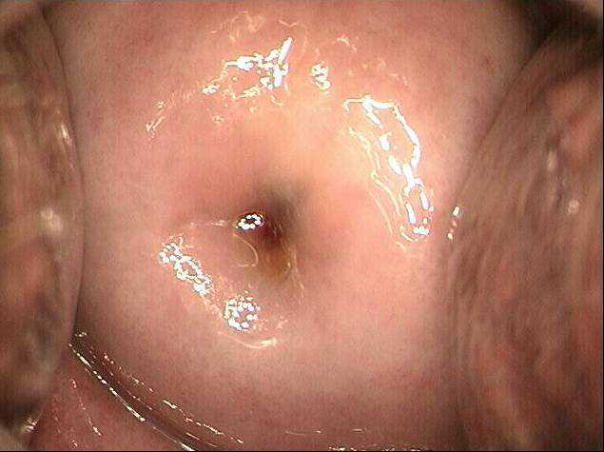
Normal Cervix
Mucosa
  Typically uniformly pink
  Epithelium intact
  Vessels intact
Normal variants are not lesions
  Ectropion
  Gland openings
  Scarring from cone biopsies

Slide 21
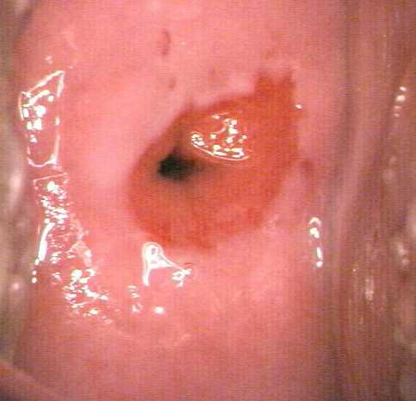
Normal Findings
Ectopy

Slide 22
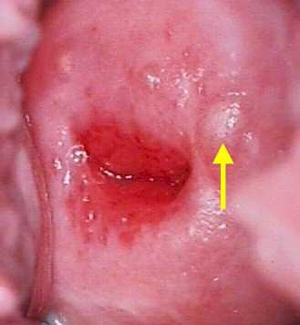
Normal Findings
Nabothian cysts

Slide 23
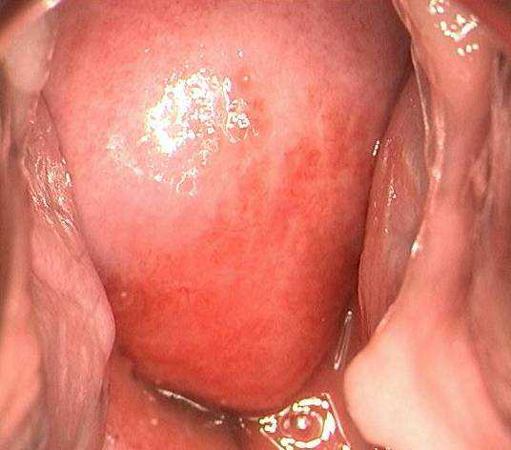
Erythema
Reddened areas
  Margins may or may not be clearly defined
  Epithelium intact
  Vessels intact

Slide 24
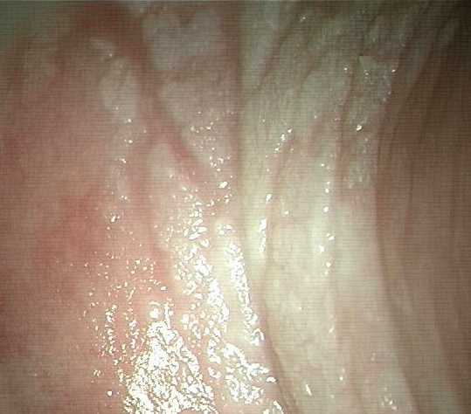
Edema
Epithelium
  Intact
  Swollen
Vessels
  Intact
Color
  Normal or pale white

Slide 25
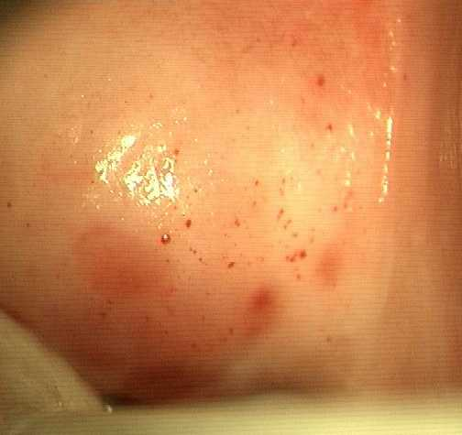
Petechiae
Punctate red areas
Individual or group
Epithelium intact
Vessels disrupted
Diameter ≤3mm
Color of finding is red or purple

Slide 26
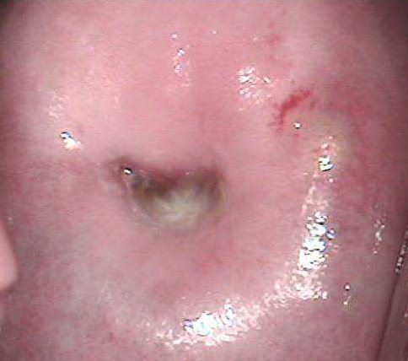
Ecchymosis
Epithelium intact
Vessels disrupted
Size >3mm
Color is red or purple

Slide 27
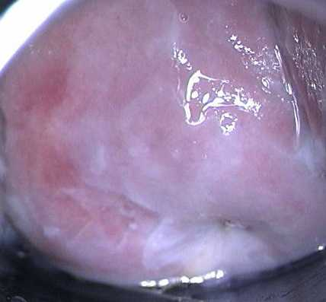
Peeling
Epithelium disrupted but superficially
Vessels intact
Fragment may remain attached to area of peeling
Generally well-demarcated
Underlying epithelium appears normal

Slide 28
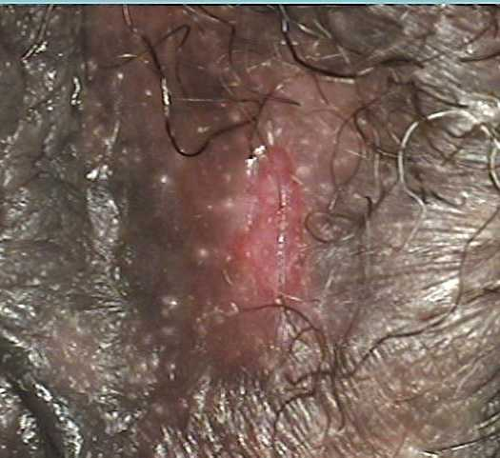
Ulceration
Disrupted epithelium
  Superficial or deep
Vessels intact or disrupted
May include sloughing
Sharply demarcated outline

Slide 29
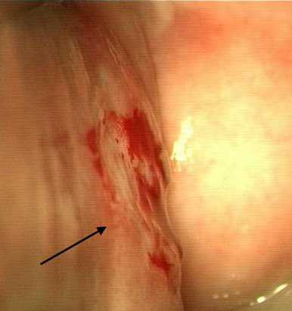
Abrasion
Epithelium disrupted
  Superficial or deep
Vessels intact or disrupted
Diffuse or poorly demarcated outline

Slide 30
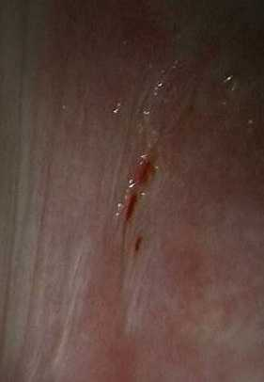
Laceration
A “cut” or “fissure”
Epithelium disrupted
  Superficial or deep
Vessels intact or disrupted
Appears to be linear “pulling apart” or wearing away of tissue

Slide 31
Pelvic Exam and Specific Visit Considerations

Slide 32
Screening Visit Pelvic Exam Considerations
As described previously, document all findings on Pelvic Exam Diagrams; abnormal findings on Screening Pelvic Exam CRF and PRE CRF
Grade 2 or higher findings are exclusionary, but a repeat exam may be performed to establish eligibility
  covered during SV Overview presentation
  so not collect pelvic specimens for storage at repeat exams

Slide 33
VR Placement Check at Enrollment and Month 1
No exam required; HOWEVER, assessment of ring placement is required!!!
Participant must demonstrate the ability to insert and remove the ring
Clinician must perform digital exam to check ring placement

Slide 34
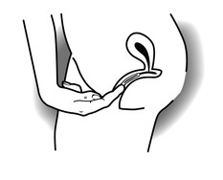
VR Placement Check
On digital exam, ring is proximal to the introitus and behind the pubic bone
Notes:
12.3.3 Clinician Instructions for Checking Ring Placement
At the enrollment visit, following insertion of the VR, the study clinician or designee should check placement of the VR, regardless of who inserted it, to confirm correct placement. The following is the procedure that the investigator or designated clinic staff should use to verify ring placement:
After ring placement, the participant should walk around prior to verification of correct ring placement.
The participant should then lie comfortably on the examination couch in supine position (on her back).
Upon genital inspection, the ring must not be visible on the external genitalia. If the ring is visible, the placement is not correct.
The ring should not press on the urethra.
On digital examination, the ring must be placed at least 2cm above the introitus beyond the Levator Ani muscle.
If, on inspection, the ring is found to be inserted correctly, the ring should be removed and reinserted correctly by the participant or the study clinician.
At the Enrollment visit, after correct placement is confirmed, the clinician should ask the participant to feel the position of her ring. This will help ensure that she understands what correct placement feels like, should she need to check this between study visits. This instruction may be repeated at any visit, as needed.

Slide 35
Unscheduled PE During Follow-up
Pelvic exams will also be conducted as clinically indicated to follow up on symptoms or adverse events identified at a previous visit
Unscheduled pelvic exams should ONLY include procedures that are necessary to the follow-up
  All procedures on the pelvic exam checklist do not need to be conducted
  Specimens are not collected unless clinically indicated for local testing (no storage specimens)

Slide 36
Specific Management Issues

Slide 37
STI/RTI
Participants diagnosed during screening with an STI/RTI/UTI requiring treatment may be enrolled after treatment is complete provided all symptoms have resolved
Document on Pre-existing Conditions CRF when diagnosed at SV if ppt will be treated and proceed to EV
  update to not ongoing at EV as applicable
    RPR seropositivity may be ongoing
    Genital herpes may be ongoing
    Genital warts may be ongoing

Slide 38
STI/RTI Management
STIs/RTIs should be treated per WHO guidelines
  Except for asymptomatic candidiasis and asymptomatic bacterial vaginosis neither require treatment per ASPIRE
WHO guidelines are minimum standard; if local guidelines set higher standard, follow local guidelines
Provide directly observed single dose regimens whenever possible
Document all treatments taken on Con Meds Log
Notes:
10.8 Vaginal Discharge
Both participant complaints and clinical findings of abnormal vaginal discharge are common in microbicide studies. While the evaluation of abnormal vaginal discharge may not differ between the two, whether treatment is offered and how the abnormality is reported may. Abnormal vaginal discharge may be associated with cervicitis, yeast, trichomoniasis, and/or bacterial vaginosis, among other conditions. Site clinicians are encouraged to thoroughly evaluate complaints and/or findings of abnormal vaginal discharge as per their discretion. Per protocol, whether to treat the underlying cause of the abnormal vaginal discharge will depend on 1. what the underlying diagnosis is and 2. whether the participant is symptomatic. If the evaluation reveals an underlying sexually transmitted infection such as trichomoniasis, the participant and her partner(s) should be offered treatment regardless of symptoms. If the evaluation reveals bacterial vaginosis or yeast, the participant should be offered treatment only if she is symptomatic.
Section 11.2.1 details the reporting of vaginal discharge Adverse Events. Briefly, sites are encouraged to distinguish whether the discharge was initially reported by the participant (“vaginal discharge by participant report”) or noted only on pelvic exam by the clinician (“vaginal discharge- clinician observed”). Importantly, in instances when the evaluation of clinician observed vaginal discharge reveals asymptomatic bacterial vaginosis or asymptomatic yeast, an Adverse Event should be filed for “vaginal discharge-clinician observed.” Even though asymptomatic yeast and bacterial vaginosis are not considered Adverse Events per protocol, in these instances, the clinician observed vaginal discharge should be captured as an Adverse Event

Slide 39
STI/RTI Management
Syndromic Management is acceptable per site SOP
STI/RTI are considered resolved when treatment has been completed and symptoms, if any, have resolved
  No test of cure is required or result needed on CRF
  NB: For exclusionary infections diagnosed during screening, treatment must be completed, and symptoms must resolve, before enrollment

Slide 40
Syphilis
Clinical management of syphilis should include repeat serology (RPR) at six-month intervals to confirm treatment effectiveness
  If RPR titre does not decrease four-fold or revert to seronegative within six months after treatment, treatment should be repeated
  NB: For syphilis infections diagnosed during screening, four-fold decrease is not required before enrollment
SV syphilis result is captured on CRF (Screening Specimen Storage) and PUEV result on PUEV Lab Results
Notes:
RPR positivity at screening should be captured as rpr seropositivty

Slide 41
Vaginal Discharge
Abnormal vaginal discharge is common and may be participant reported or clinician observed
Evaluation is per clinician discretion and should be the same regardless of identifying source
Treatment, however, may differ
  If underlying diagnosis is STI, treat
  If asymptomatic BV or yeast, no treatment required
Record AE
  Verbatim term should be underlying diagnosis (trichomonas, for example) UNLESS asymptomatic BV or yeast is uncovered
  In that case, record “vaginal discharge per ppt report” or “vaginal –discharge-clinician observed”
  If discharge is both participant reported and clinician observed, record “per ppt report”

Slide 42
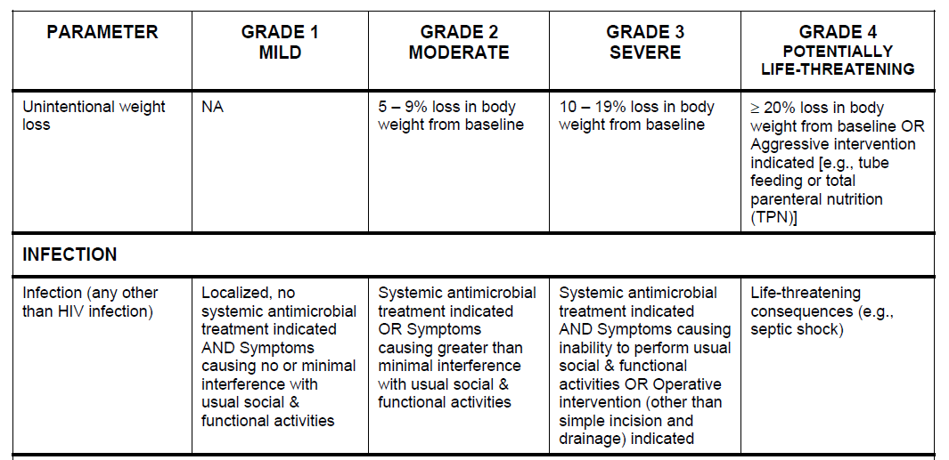
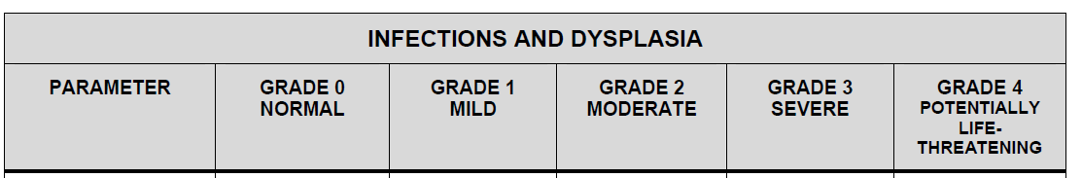
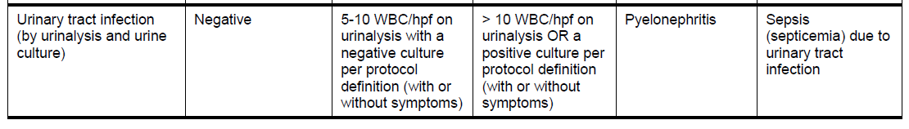
Urinary Tract Infections
In ASPIRE, UTI is diagnosed by symptoms
If diagnosed symptoms, grade by the main tox table
If diagnosed by culture or urinalysis, grade per UTI row of the FGGT

